Slide 1
Common grazings in Scotland – assessing their value and rewarding their management
Gwyn Jones

Slide 2
About Scotland
79,000 sq. km; Northern 1/3 of UK
Political union with England in 1707, but retained own legal system, including land law
Legislative and administrative autonomy under Scottish Parliament, including over agriculture, regional policy, environment

Slide 3
History of common grazings in Scotland
Alasdair Ross – most of Scottish open land legally divided between communities by 1000
Estimated that half of all land was common in 1500
Acts of 17th century enabled enclosure; by 19th century common land restricted mainly to N&W
Expansion of sheep farming as part of ‘Agricultural Revolution’ – trend to clear remaining commons and associated peasants in 19th century – “Highland Clearances”

Slide 4
Legal intervention
Clearance continued into time of ‘politics’ and mass media
Led to passing of the Crofters’ Holdings (Scotland) Act 1886
  Security of tenure
  Control of rents
Crofters’ Common Grazings Regulations (Scotland) Act 1891
  Allowed setting up of grazings committee to administer grazings
  Allowed committees to draw up and implement regulations
  Oversight by Government

Slide 5
Effects of the Crofting Acts
Change in power relationships
  Between landlord and crofter
  Between crofter and State
  To some extent, between crofters and each other
Slowing down of structural change
  Holdings remained numerous and small
  Grazings remained largely unapportioned
  Communal working of various types remained common

Slide 6
Public goods – what are they?
Definition
  Non-rivalry
  Non-excludability
  So in contrast with private goods, no market to set a price for them
  Usually produced as incidentals of other activities; degree of coupling varies
  If supply is threatened, implies State intervention
Examples
  Beautiful landscape
  Biodiversity
  Carbon storage

Slide 7
Economics of Blackface sheep on poor land in NW Scotland (GBP, per 100 ewes)
Gross margin before subsidy | -756
Non-labour fixed costs (up to…) | -500??
Labour costs (200 hr. now, but likely to rise) | -1500??
Net margin before subsidy | -2700??

Slide 8
Economics of Blackface sheep on poor land in NW Scotland (GBP, per 100 ewes)
Gross margin before subsidy | -756
Non-labour fixed costs (up to…) | -500??
Labour costs (200 hr. now, but likely to rise) | -1500??
Net margin before subsidy | -2700??
Subsidies | 2200
Net profit with subsidy | 500

Slide 9
Return on labour
Profit of £500 just now
For a family time commitment of 200 hrs - £2.50/hr
Minimum wage is >£6/hr
But with decoupling could claim £1500 SPS
AND actually earn at least £1200 in a minimum wage job
£2700 clear of any costs!!

Slide 10
Public support to farming in northern Scotland
Direct payments to support production since the 1940s, with top-ups for remote, marginal areas
  Headage payments, price support mechanisms
  Single Payment Scheme (SPS) and Less Favoured Area (LFA) support, now paid on per ha basis
Agri-environment measures
Potential problems on common grazings:
  Direct payments: area of eligible forage
  Agri-environment: applicant has to be grazings committee

Slide 11
About this project
Funding from
  Highlands and Islands Enterprise
  Scottish Natural Heritage
  Shetland Islands Council
  Comhairle nan Eilean Siar
  Highland Council
  European Commission (DG Env)
Help from
  RSPB
  Macaulay Land Use Institute
  SCF local areas

Slide 12
About this project
To give a snapshot of common grazings and their use in 2010
To provide some information on the relative significance of common grazings, economically, socially and environmentally
To assess the degree to which shareholders on common grazings experience now or will potentially experience after 2013 disadvantages in accessing CAP funding relative to their importance and to the difficulties faced by comparable claimants with no common grazings
To set the findings in a policy context, and set out recommendations for action.

Slide 13
Methods
Scottish Government data
  IACS
  Local office spreadsheets (c. ¼ of grazings)
Questionnaire of about half clerks in half the parishes (~NUTS IV)
Some meetings with graziers, discussions with stakeholders, funders

Slide 14
Area & distribution
Total: 591,901 ha
Land actually used in common (this map): 537615 ha
Another 54286 ha not on IACS?

Slide 15
ALL SFP claimed area – importance of common grazing

Slide 16
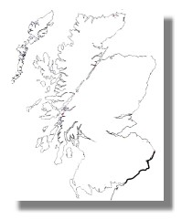
An example – Kilmuir parish

Slide 17
ALL SFP claimants – importance of common grazing

Slide 18
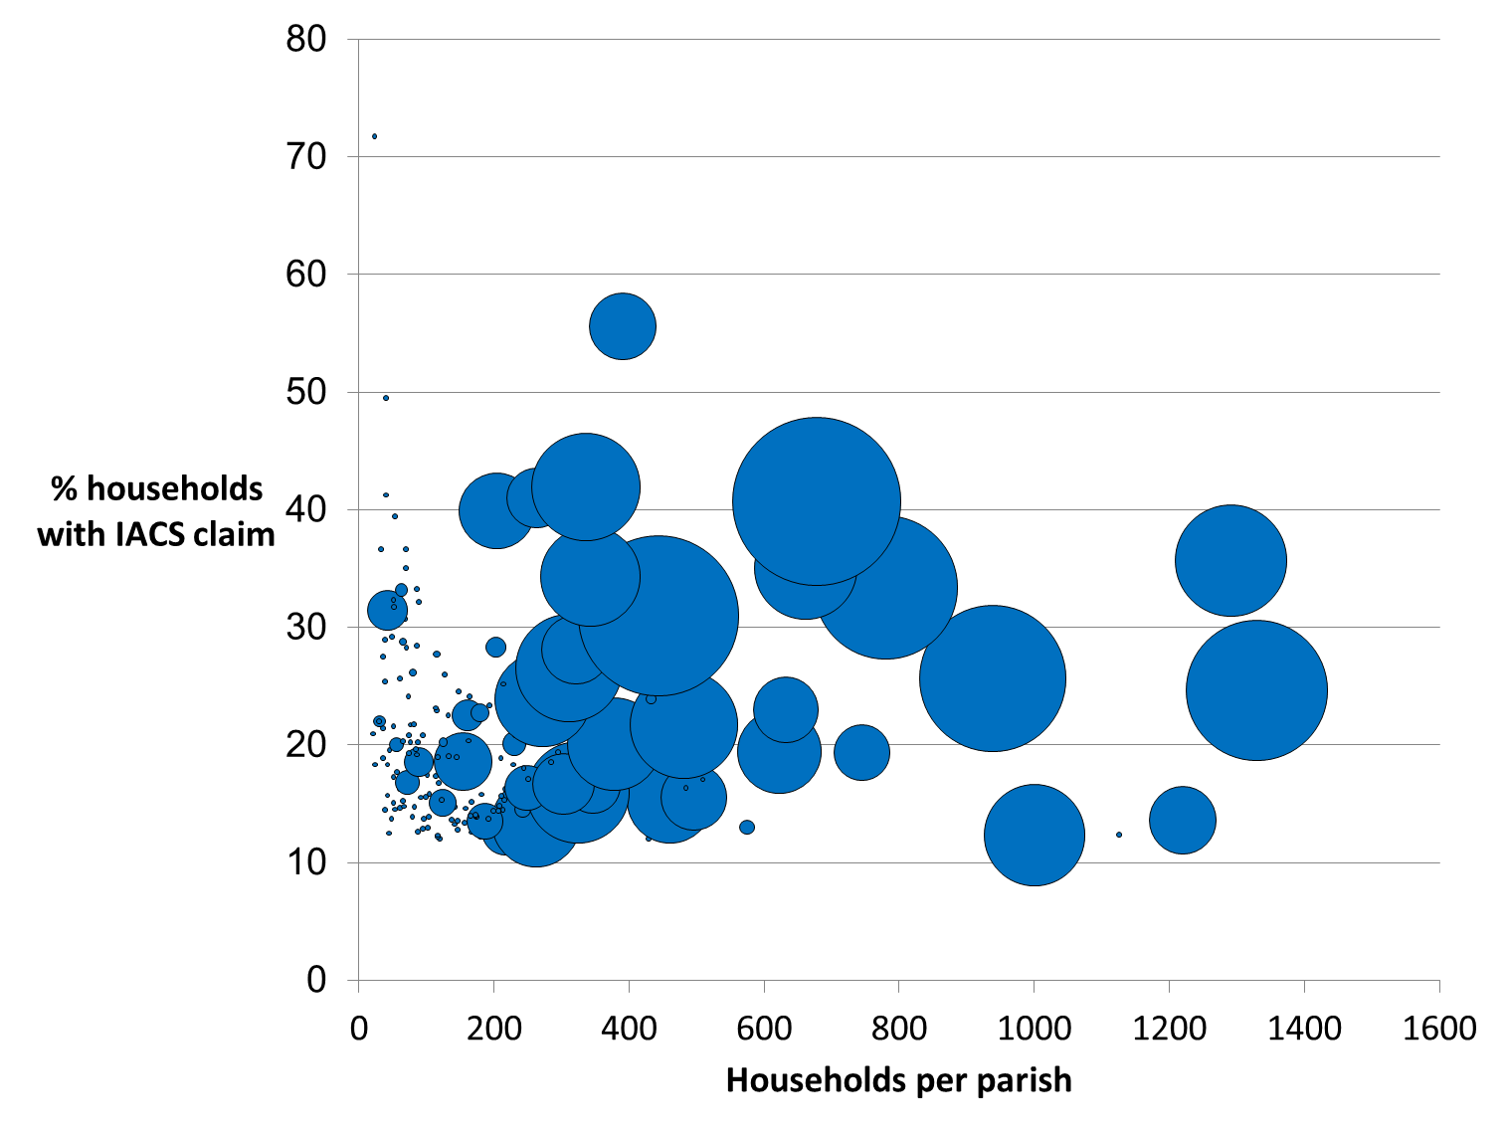
More people with IACS
Area of circles proportional to area of common grazings in IACS

Slide 19
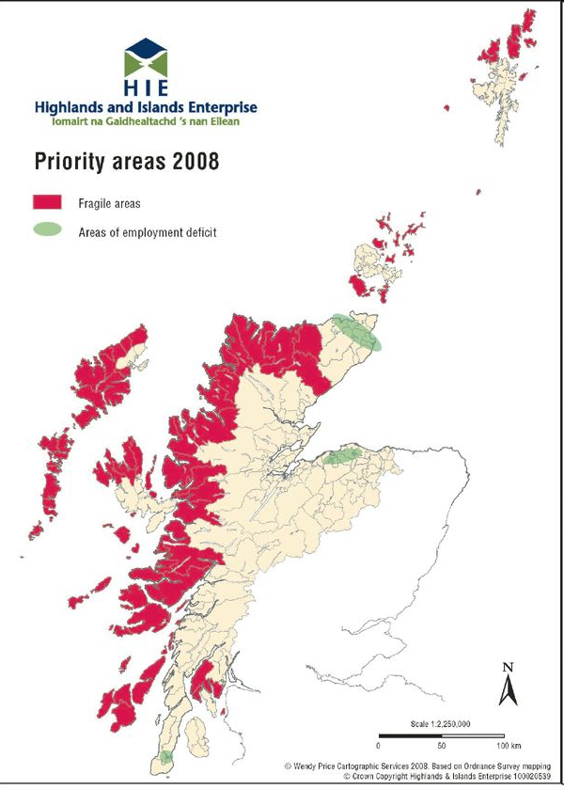
69% of CG claimants and area found in socio-economically marginal areas

Slide 20
A lot is of national/ international value for biodiversity
27% of common grazings are designated
21% is SPA
15% is SAC
16% is SSSI
Common grazings are 7% of Scotland
But 8% of SSSI
11% of non-marine SAC
13% of SPA

Slide 21
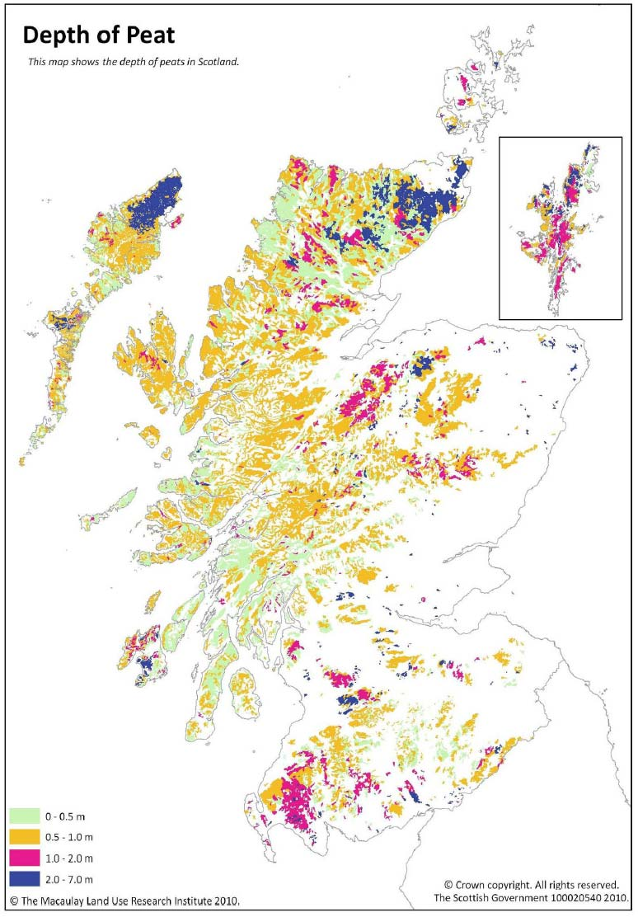
Important for carbon storage
Common grazings cover 7% of the land area of Scotland
49% of the area under common grazing in Scotland is on peat soils
15% of the peat area of Scotland is under common Grazing
30% of the peat over 2m deep is under common grazings
Common grazings contain 10% (324 Mt) of the total Carbon in Scottish Soils.

Slide 22
Portree & Inverness areas – forage NOT claimed (SFP claim, 2009)

Slide 23
Actual forage versus claimable forage, Portree & Inverness IACS 2009 claims

Slide 24
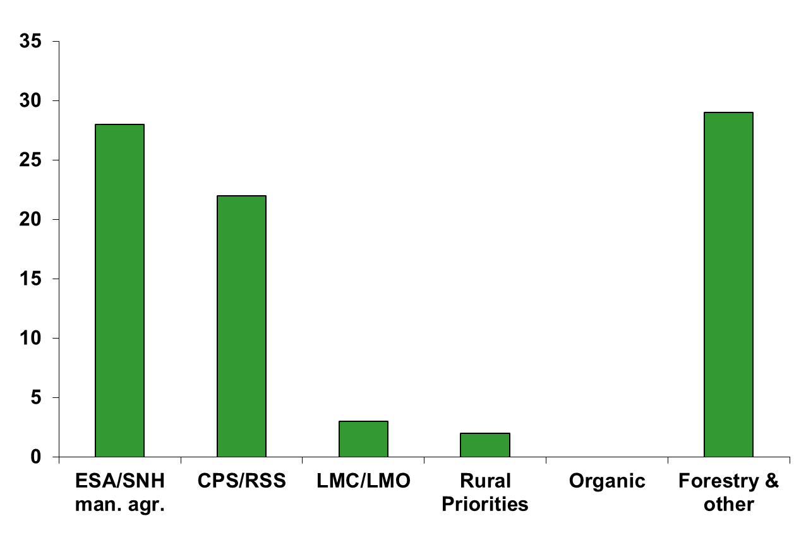
Sample grazings – scheme participation

Slide 25
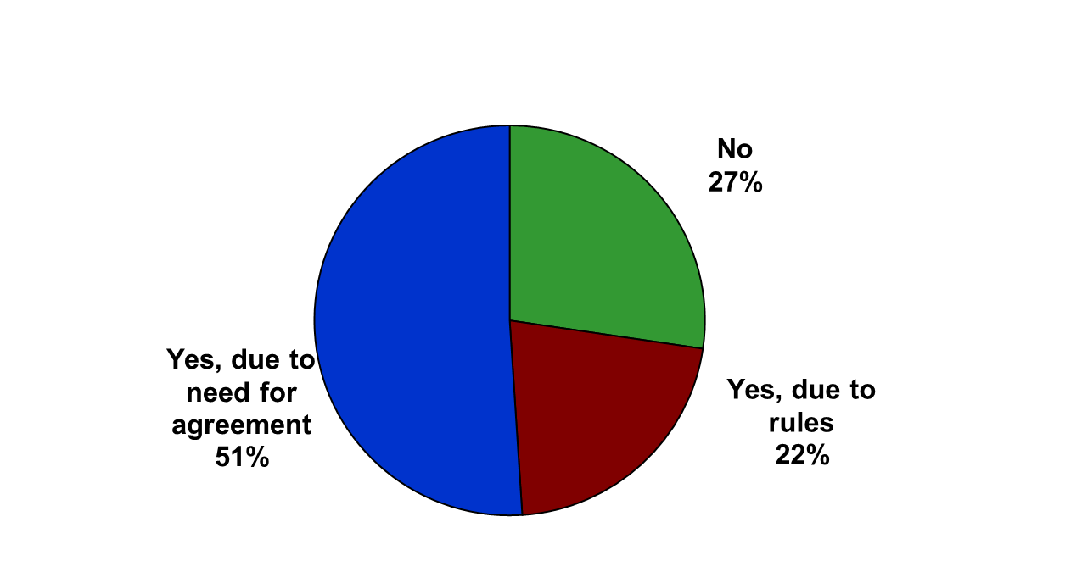
Do common grazings have more problems getting into schemes than hill farms?

Slide 26
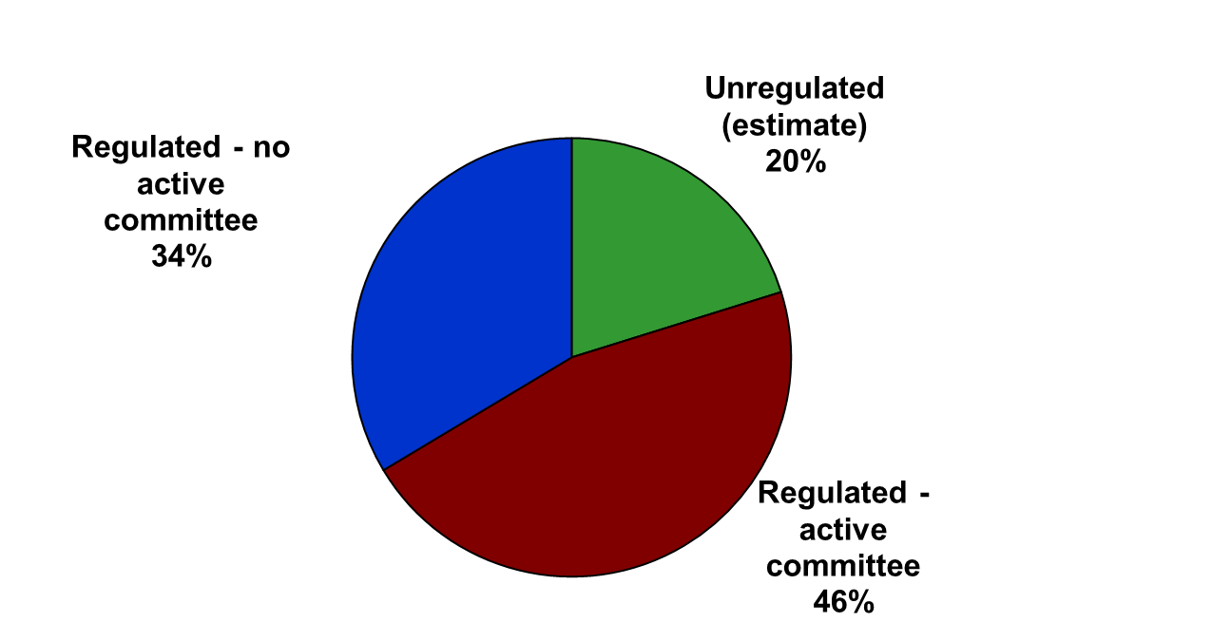
Administrative capacity

Slide 27
Who should be allowed to claim SFP?

Slide 28
How is scheme money shared (townships in AE)?

Slide 29
Reallocation of forage shares annually?

Slide 30
Weaknesses in policy process
Lack of a truly integrated territorial vision.
Lack of attention to common grazings by crofting bodies.
Inability to separate out common grazings (and crofts) in wider datasets.
Lack of attention to common grazings in policy strategies and programmes. Decreasing attention given to capacity building within grazings institutions

Slide 31
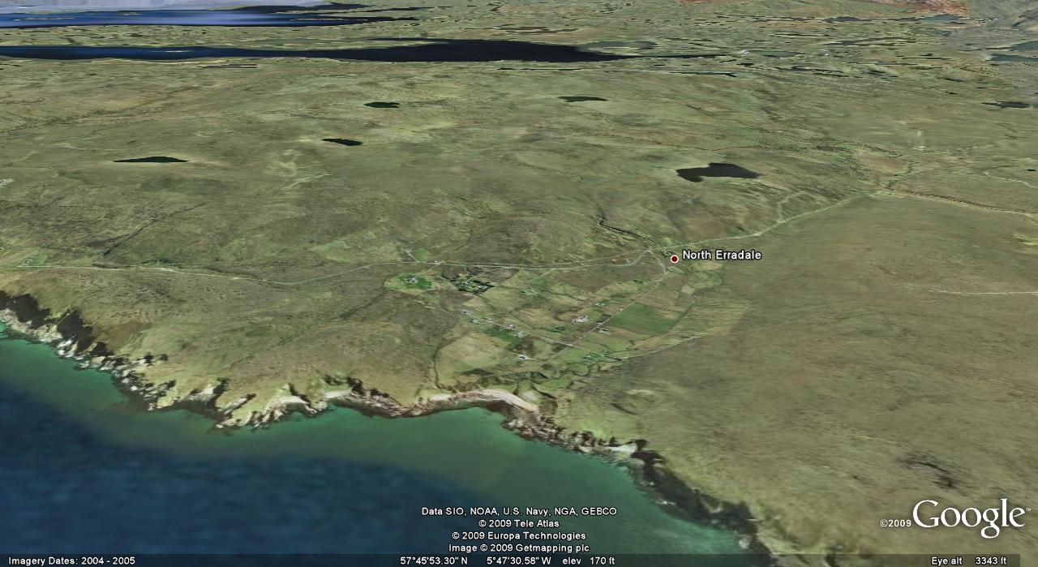
A good test for any rural policy:
Does it work on common grazings?

Slide 32
www.efncp.org
gwyn@efncp.org

