Slide 1
Wye Valley: grasslands, grazing and a Local Partnership Project
Andrew Blake, Wye Valley AONB
Paul Silcock, Cumulus Consultants

Slide 2
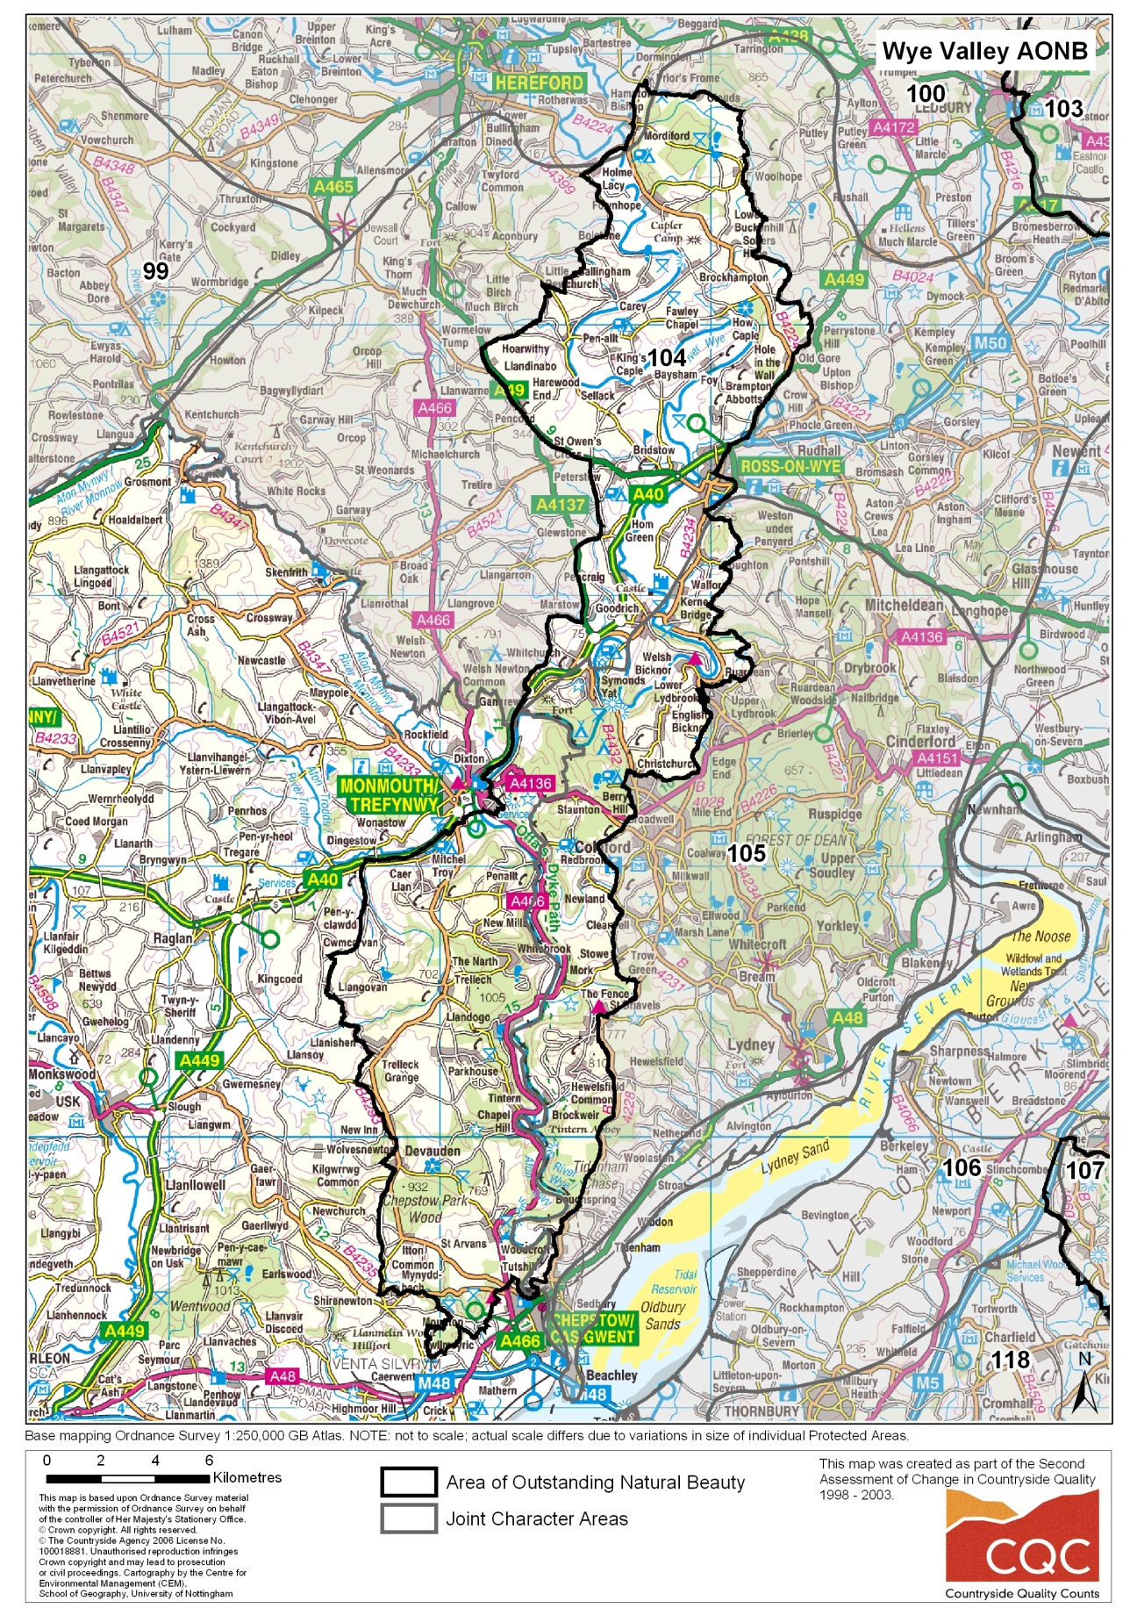
326 km²
92km River Wye
65% farmland
7 - 14% HNV
27% woodland
3 SACs
4 NNRs
45 SSSIs
123 SAMs
204 local wildlife sites

Slide 3
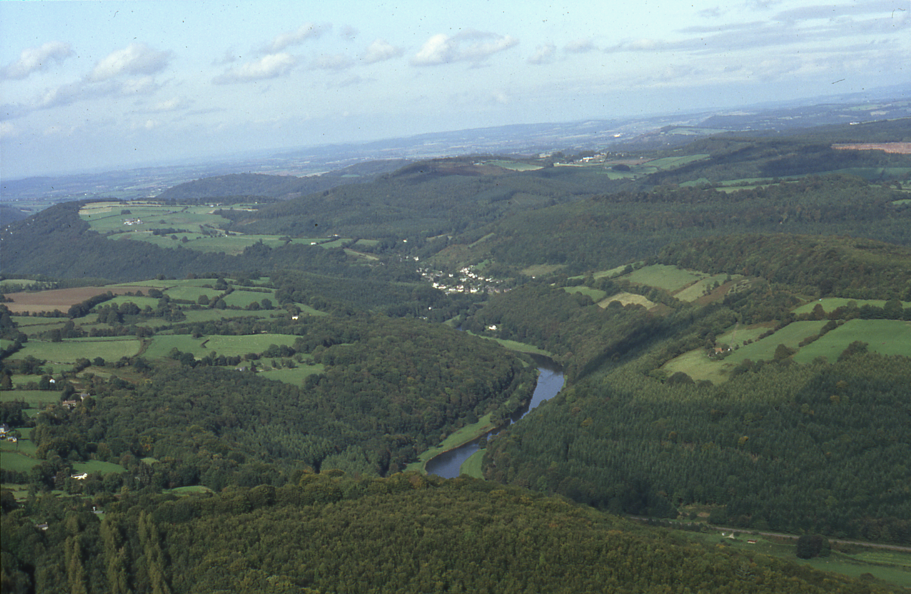

Slide 4
Grasslands
Old meadows, orchards and pasture
Mostly NVC MG5
+ limestone grassland & heathland
Small fields bounded by drystone walls, thick hedges &/or woodland
Often ‘amateur’ landowners

Slide 5
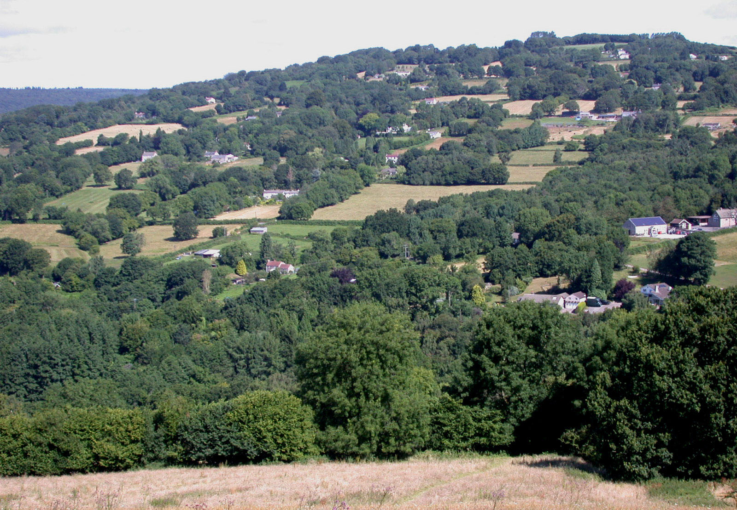

Slide 6
Existing projects
Woolhope Dome Project (2001-2009)
Parish scale biodiversity enhancement project
Wye Valley Graziers (2002-2007)
Post FMD livestock farmers v CAP Reform
Parish Grasslands Project (2001- - )
community-based initiative to assist ‘amateur’ grassland owners: 70 members / 100ha
Monmouthshire Meadows Group (2003 - - )
Welsh sister to Parish Grassland Project: 80 members / 200ha

Slide 7
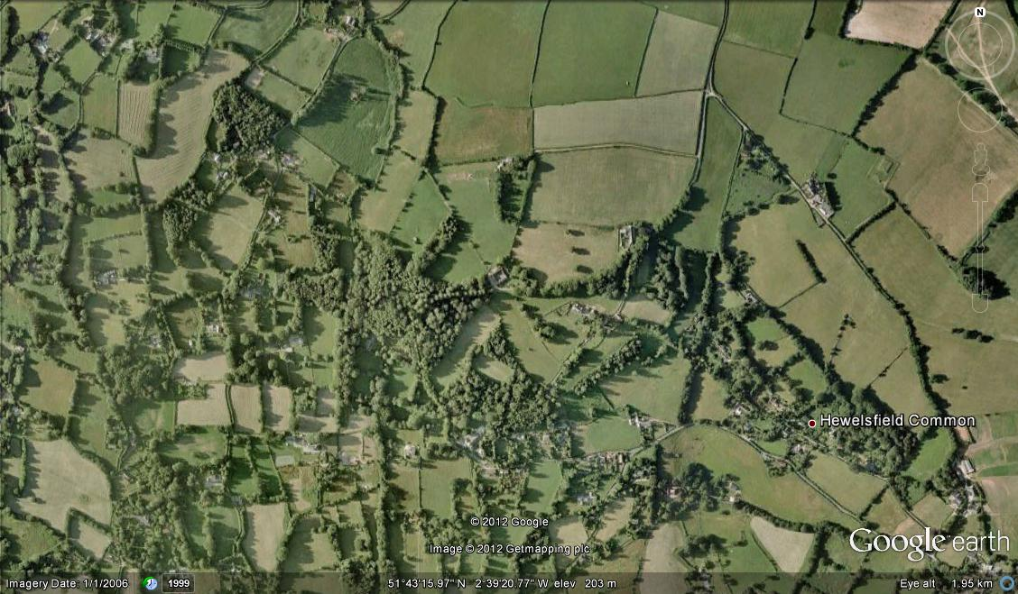

Slide 8
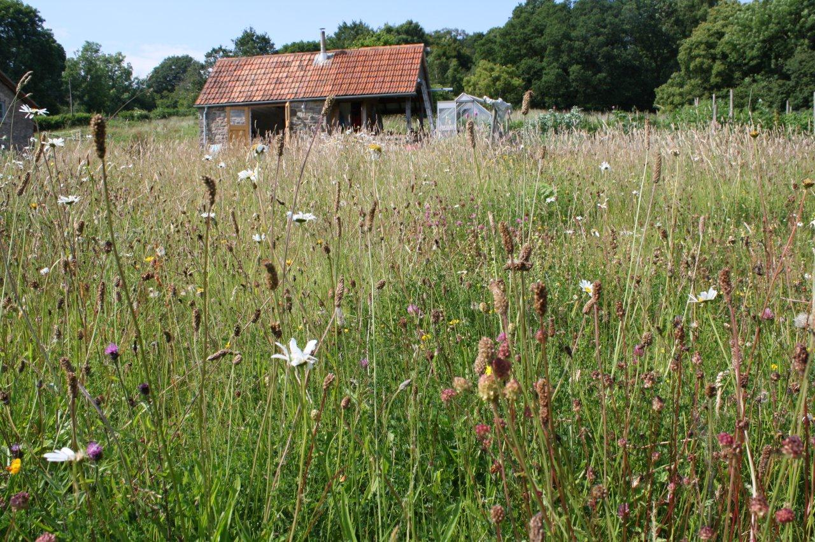

Slide 9
Successes
Community driven
Improved landowner awareness
Linkage to local farmers and contractors
Management and infrastructure delivered
Advice and training provided
Identification and designation of sites
Involvement of children and young people
External funding sourced

Slide 10
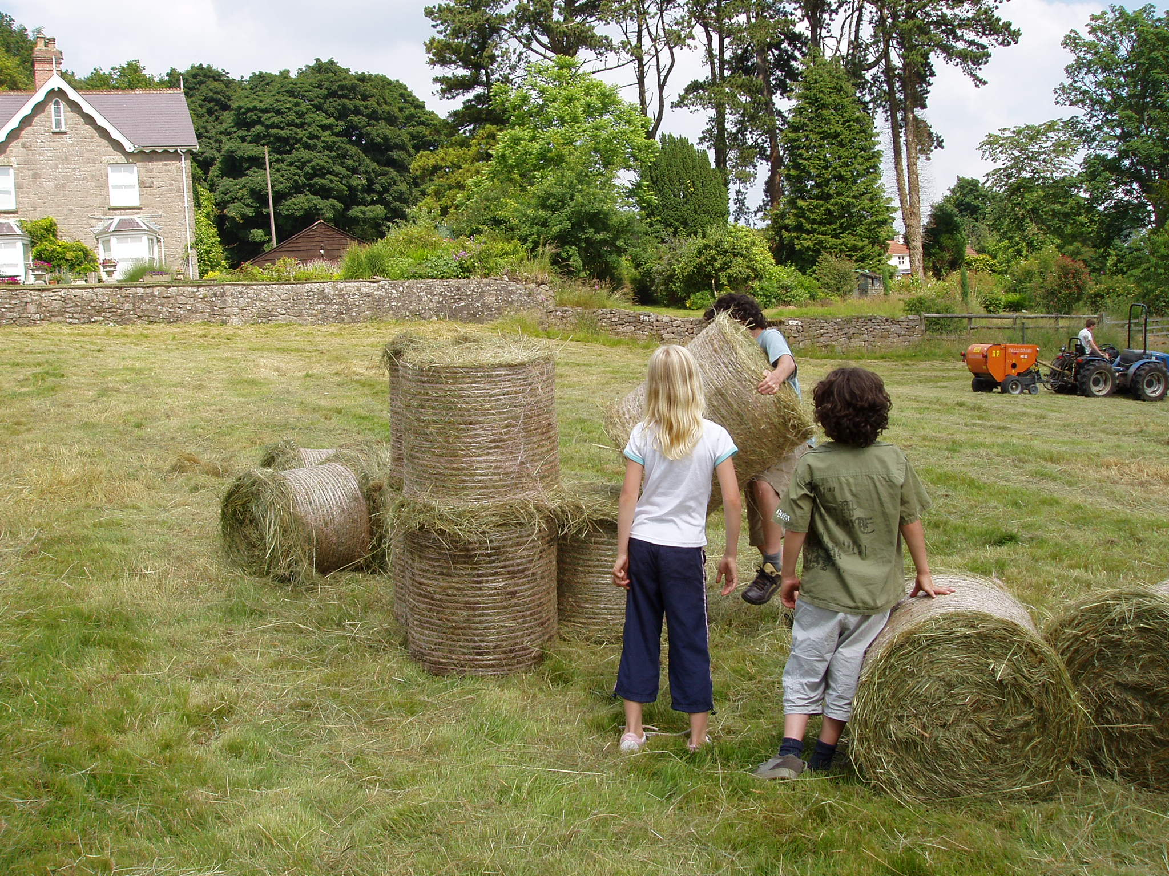

Slide 11
Issues encountered (1)
Poor profitability of livestock enterprises
Livestock disease and associated bureaucracy
Reduction in livestock numbers and cattle/sheep ratio
And in key areas with small sites etc:
Lack of grassland management
loss of sites in worst cases
Changing social patterns
landowners without farming/conservation skills, fewer commoners with livestock

Slide 12
Issues encountered (2)
Machinery availability and use
required, where no grazing available
Infrastructure requirements and cost
Initially funded, now requires replacing, expensive on small sites
Agri-environment payments
Small, insufficient payments for small sites; bureaucratic application process
AE schemes not targeted at small landowners
Lack of landowner interest and awareness
Some do not mind scrub, or wish to plant trees

Slide 13
Lessons learned
Local ownership vital
Committed individuals and active farmers needed
Collaborative approach and co-ordination required with ‘amateur’ landowners and small sites
Machinery: income required to reinvest
Funding ‘mish-mash’ affects project continuity
Sustainable livestock farming requires long term commitment

Slide 14
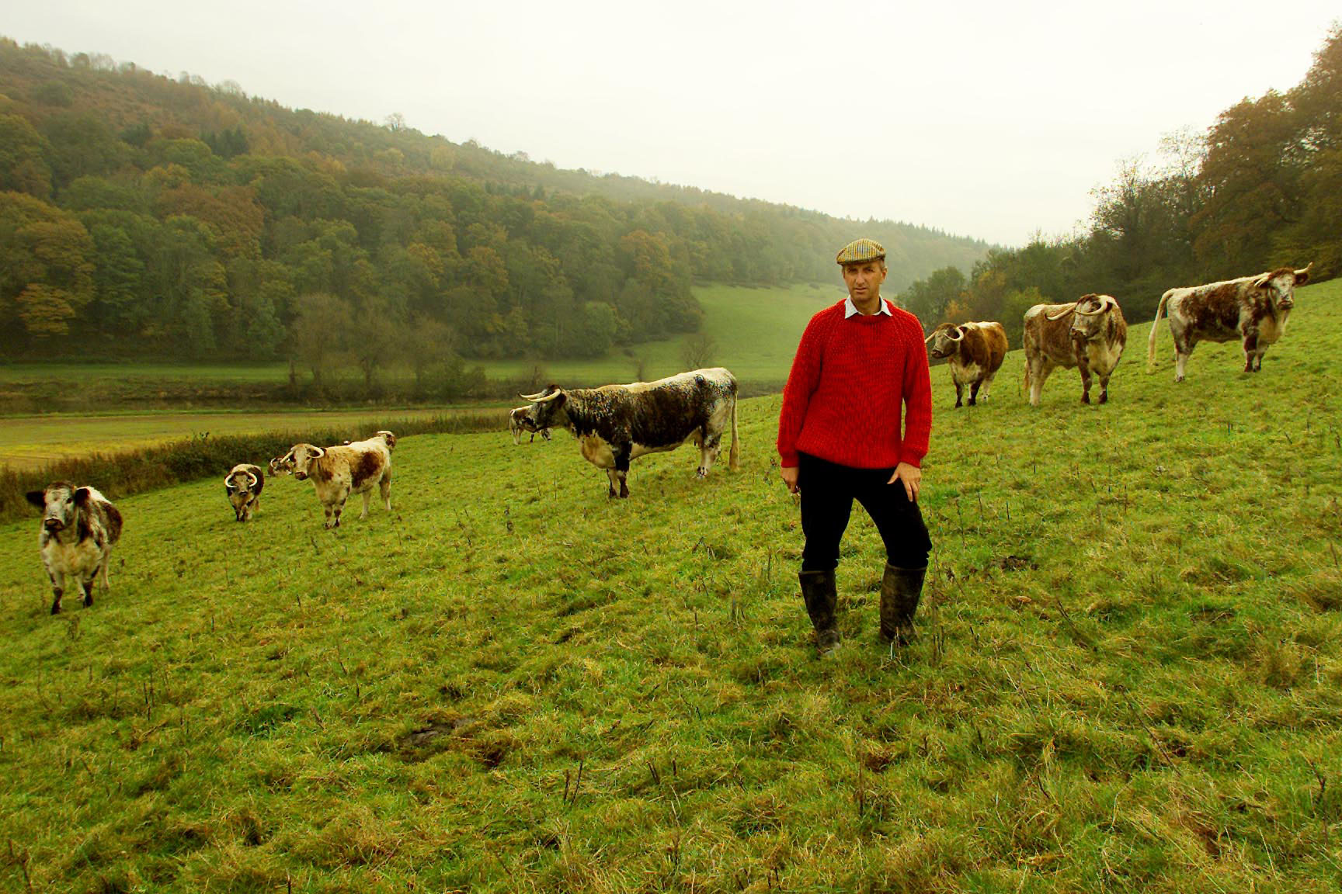

Slide 15
⬇ Local Partnership Project (LPP) approach

Slide 16
LPP need
Help people to help themselves - collaboratively
Address specific needs of ‘amateur’ landowners and small sites not presently covered by RDP
Be ambitious enough to target whole HNV resource – building on previous projects
Provide long term funding, continuity
Focus on long term sustainability

Slide 17
LPP – policy context
EFNCP proposal to EC for LPPs from 2014
EAFRD regulation - COM(2011)627/3 – Article 36 makes provision for:
“co-operation” involving different entities such as agriculture, food chain, forestry... approaches;
co-operation among small operators in organising joint work processes, sharing facilities and resources;
promotion activities in a local context relating to the development of short supply chains and local markets;
collective approaches to environmental projects and practices

Slide 18
LPP objectives (1)
Conserve and enhance HNV grassland in area (2,000+ ha)
Advice on grasslands and grassland management
Capital work payments for land management or re-introduction of livestock, alongside AES
Support and promote extensive farming systems
Support for existing farmers going into traditional breeds and new graziers/entrepreneurs
Support for group or individual marketing initiatives
Advice on AES, RDP and other grant applications

Slide 19
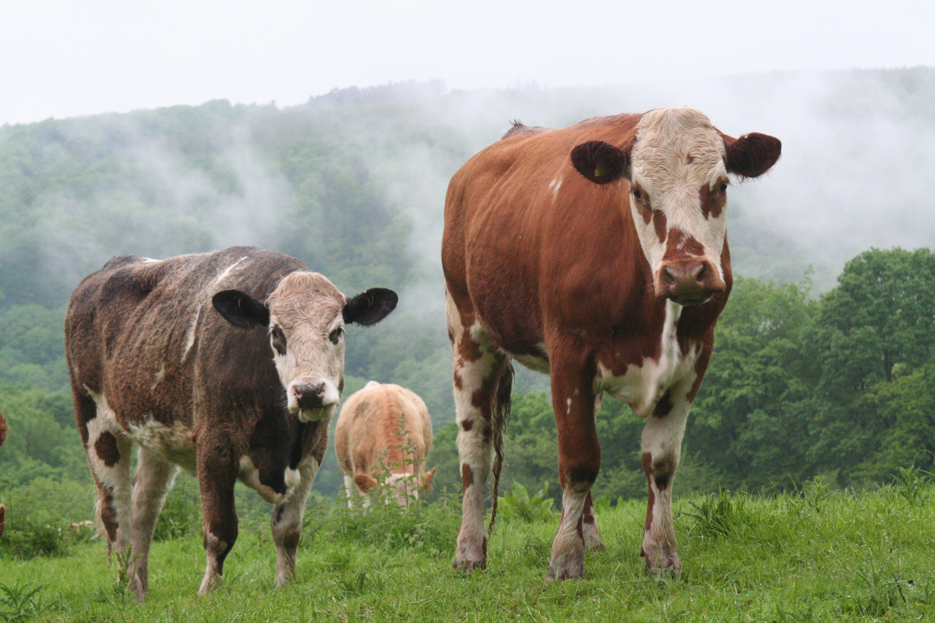

Slide 20
LPP objectives (2)
Engage local communities and improve contribution of grassland sites to local economy
Support for local grassland groups and volunteers
Education and training (rural skills, farm business, conservation)
Outreach to children and young people
Directory of graziers, contractors, local businesses, grassland groups, specialists

Slide 21
LPP outcomes
HNV grassland in area under positive management
More farmers grazing and cutting HNV grasslands, profitably
More non-farming businesses and local people involved with HNV grasslands
More grassland groups, improved awareness
More resilient grassland sites and more sustainable management systems

Slide 22
LPP scope
Area: ideally semi-natural grassland across the AONB (2000ha+)
different issues/needs across area suggest different services – North & South target areas?
Timescale: long term, but initial 7 year term linked to RDP

Slide 23
LPP finance and funding
Indicative budget of £1m for initial 7 year term
RDP funding from England and Wales plus other external funding
Working alongside existing schemes and initiatives

Slide 24
